Slide 1
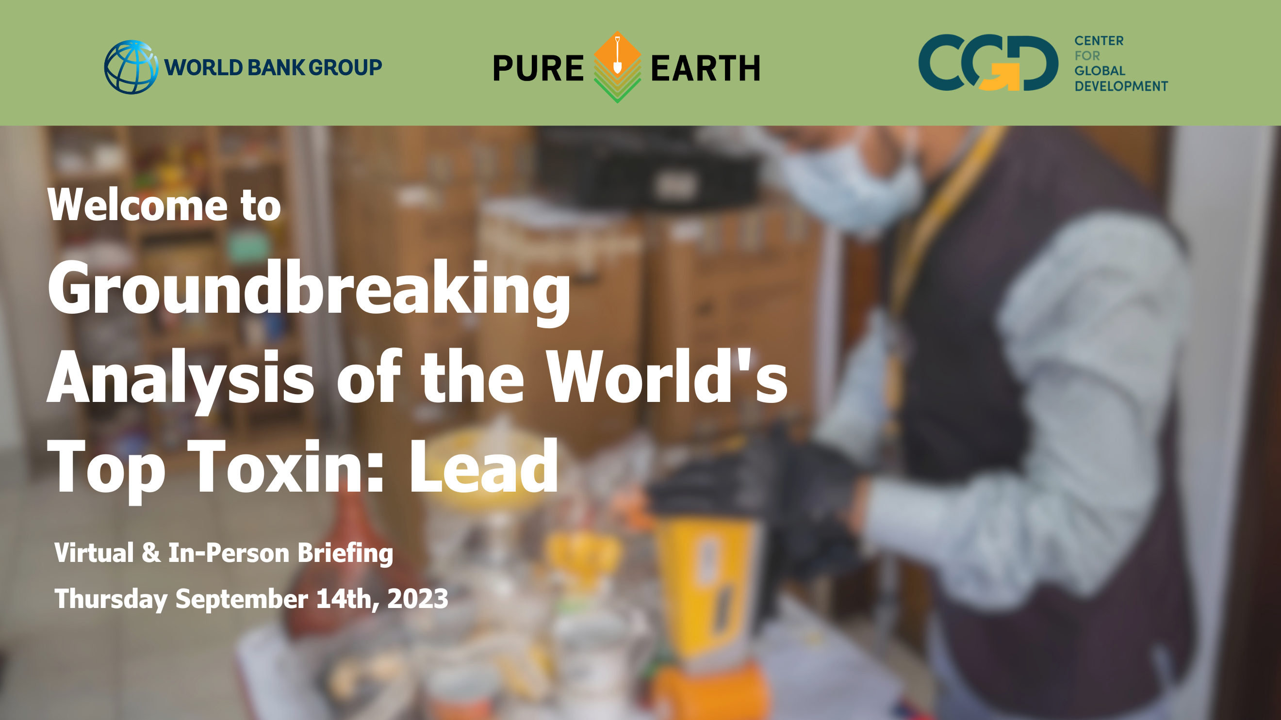

Slide 2
Bjorn Larsen and Ernesto Sanchez-Triana
World Bank
Bjorn Larsen and Ernesto Sanchez-Triana
World Bank

Slide 3
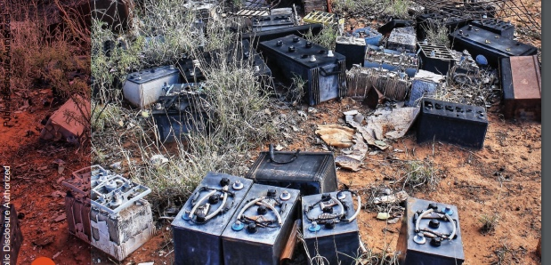


The global health burden and cost of lead exposure in children and adults
Lead Briefing Event
World Bank, Pure Earth, and Center for Global Development
New York
September 14, 2023
Bjorn Larsen and Ernesto Sanchez-Triana
World Bank

Slide 4
Presentation
This presentation draws on recent research at the World Bank:
Forthcoming in: ‘A World without Lead Poisoning: Health, Development and Economic Impacts’
Lancet Planetary Health:
‘Global health burden and cost of lead exposure in children and adults: a health impact and economic modeling analysis’
by Bjorn Larsen and Ernesto Sanchez-Triana
https://doi.org/10.1016/S2542-5196(23)00166-3

Slide 5
Contribution of this study
This study presents for the first time :
IQ loss in children from lead exposure in both low- and middle-income countries (LMICs) and high-income countries (HICs);
Global cardiovascular disease (CVD) mortality from lead exposure mediated through other mechanisms than blood pressure (e.g., atherosclerosis);
Global cost of these health effects.
Why focus on CVD and IQ loss (indicator of health effects)?
  Because they are considered the most substantive quantifiable effects of lead, but there are many more health and behavioral effects

Slide 6
We used country BLL estimates from GBD 2019
Average BLLs were 3.5 times higher in LMICs than in HICs (4.6 vs. 1.3 µg/dL) in 2019
We estimate that:
As many as 46% of children and adults in LMICs may have BLL > 5 µg/dL
As many as 28% of children and adults in LMICs may have BLL > 10 µg/dL

Slide 7
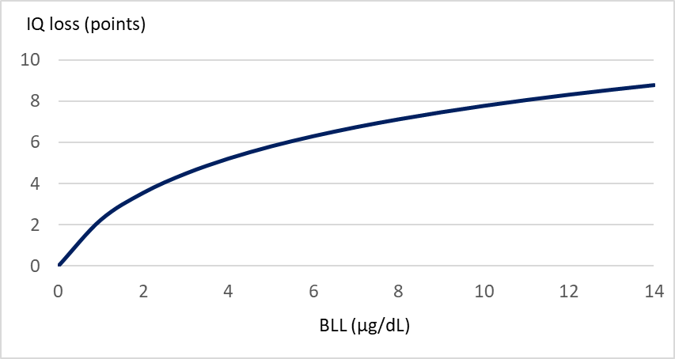
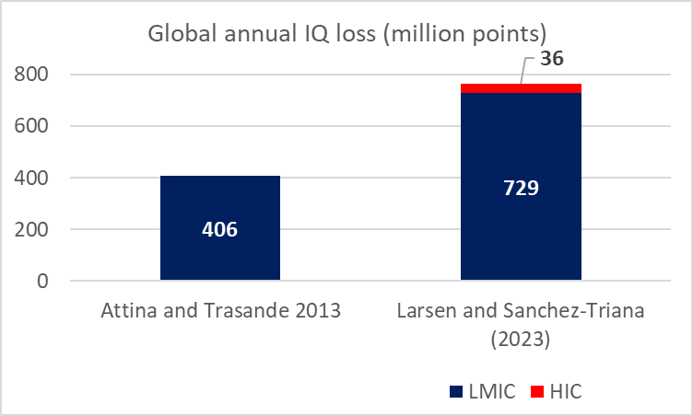
We find that annual IQ losses in children from lead exposure may be 80% higher than previously estimated
Based on the BLL – IQ loss relation in Crump et al (2013)
New estimate by Larsen and Sanchez-Triana (2023) is based on the BLL – IQ loss relation in Crump et al (2013)

Slide 8
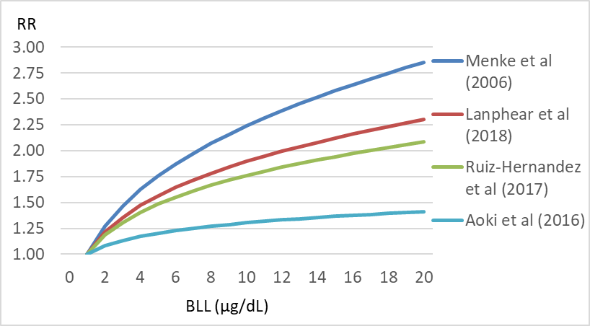
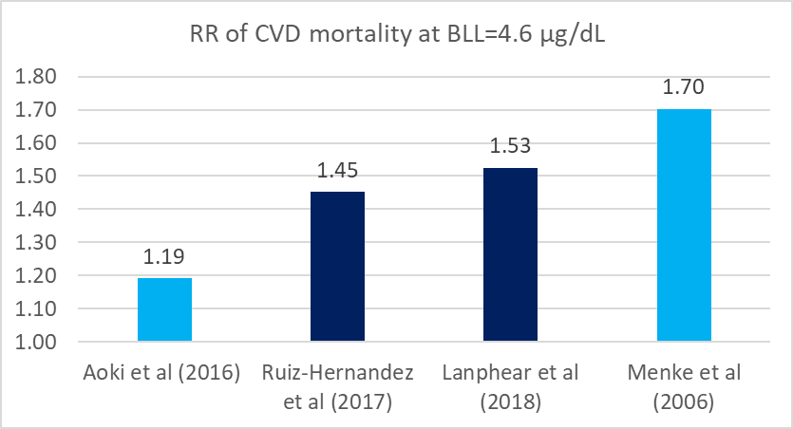
CVD mortality risk from Pb exposure:
Left: Evidence from 4 large studies in the United States
Right: CVD mortality risk at the average BLL of 4.6µg/dL in LMICs
We used the average of Ruiz-Hernandez et al (2017) and Lanphear et al (2018) for our central estimate of mortality risk.

Slide 9
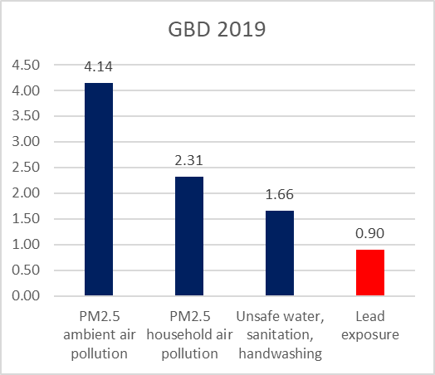
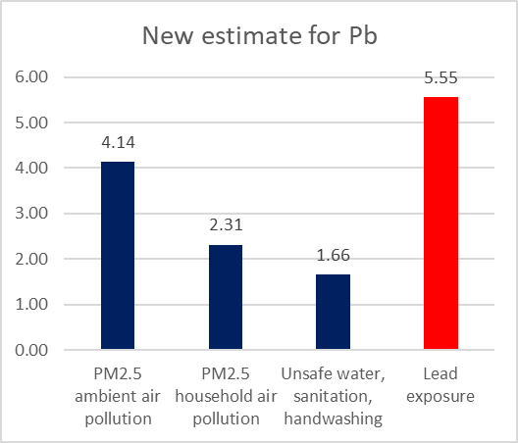
CVD mortality (million deaths in 2019) from lead exposure may be 6 times higher than estimated by the GBD 2019
Deaths (million) in 2019 from major environmental risk factors
New estimate for Pb from Larsen and Sanchez-Triana (2023) is based on Ruiz-Hernandez et al (2017) and Lanphear et al (2018)

Slide 10
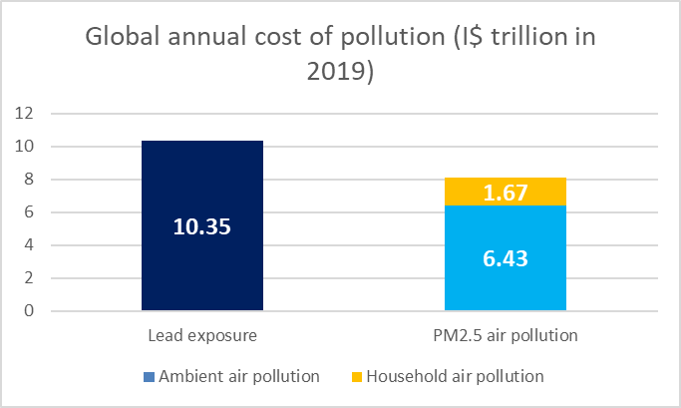
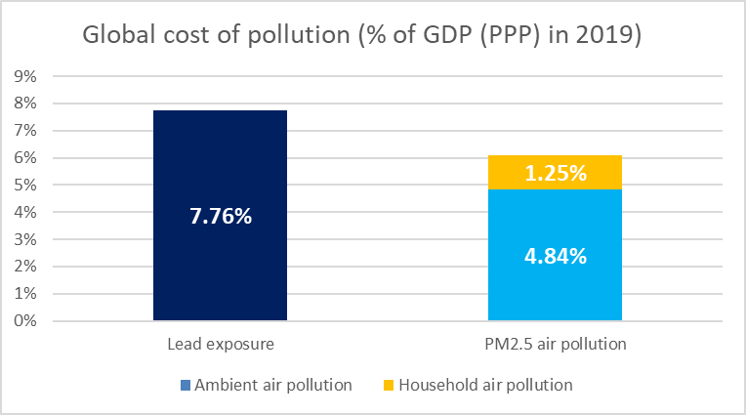
Global cost of lead exposure may be higher than the cost of
PM_{2.5} ambient and household air pollution combined
Source: Global cost of air pollution is from World Bank (2022). Global cost of Pb exposure is from Larsen and Sanchez-Triana (2023).

Slide 11
Conclusions
The global health effects and cost of lead exposure may be as large as or even larger than the health effects and cost of PM_{2.5} ambient and household air pollution combined.
The estimates indicate that lead exposure may be the third largest risk factor for CVD mortality, exceeded only by high blood pressure and dietary risks, and ahead of tobacco smoking and high cholesterol….and it contributes to high blood pressure as well.
This means lead exposure in LMICs can no longer be taken lightly.

Slide 12
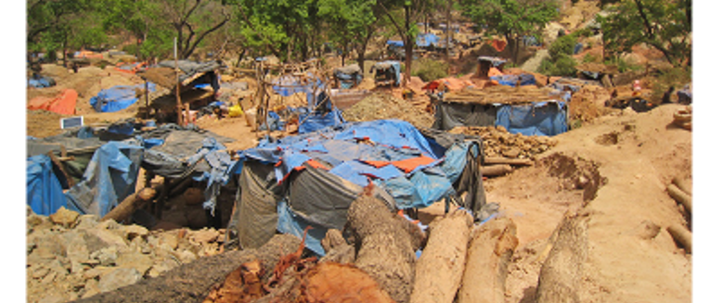
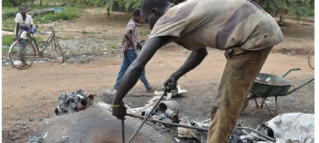
Thank you

Slide 13
Ana Navas-Acien, MD, PhD
Columbia University Mailman School of Public Health

Slide 14





Cardiovascular Effects of Lead Exposure
Ana Navas-Acien, MD, PhD
Professor and Vice-Chair of Research
Department of Environmental Health Sciences
Director, Columbia Northern Plains Superfund Research Program
Columbia University Mailman School of Public Health
January 19, 2023

Slide 15



Slide 16
Mechanisms of Lead Cardiotoxicity
Credit: Koren Mann
Ujueta et al. Tox Sci 2021

Slide 17
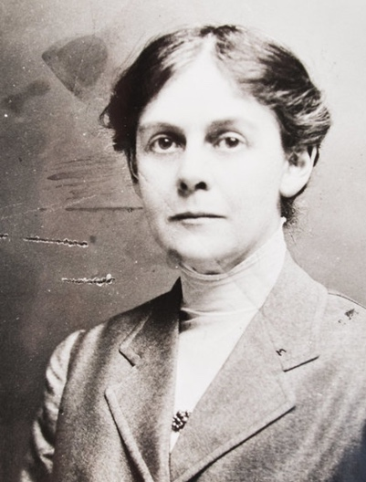
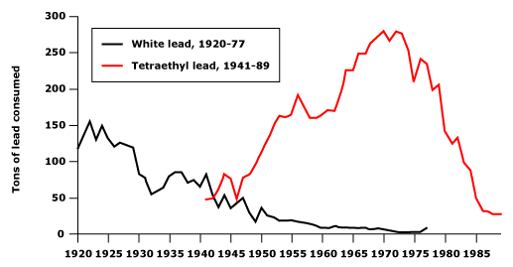


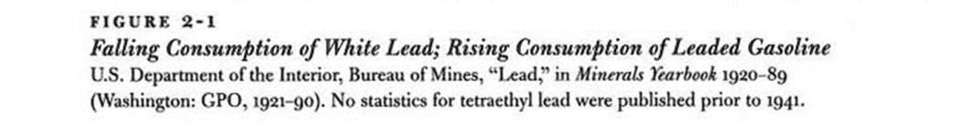
Massive lead exposure in USA in the 20th century
Peak lead production
1968
Alice Hamilton
January 2012
Notes:
Anybody born and living in the US between 1945 and 1970s – extremely high levels of exposure to lead and to some extent also to cadmium

Slide 18
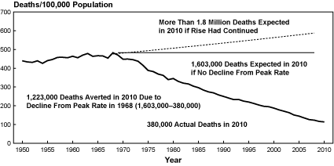


More than 1 million cardiovascular disease deaths avoided in the USA in 2010 vs. 1968
Peak CVD deaths
1968
http://www.nhlbi.nih.gov/about/documents/factbook/2012/chapter4

Slide 19


Can temporal changes in lead exposure explain the reduction in CVD mortality observed in the US?
Maria
Tellez Plaza
Blood lead
Urine cadmium
All CVD-deaths
Ruiz-Hernandez et al. Int J Epidemiol 2017

Slide 20
TACT 1 Trial - All cause death – CVD in Diabetes patients
EDTA Chelation vs. Placebo
HR (95% CI): 0.57 (0.36, 0.88); P = 0.0111
Placebo
EDTA
Number at Risk:
EDTA
Chelation 322 303 283 267 251 230 222 211 193 160 101
Placebo 311 293 275 250 227 205 195 174 151 128 83

Slide 21
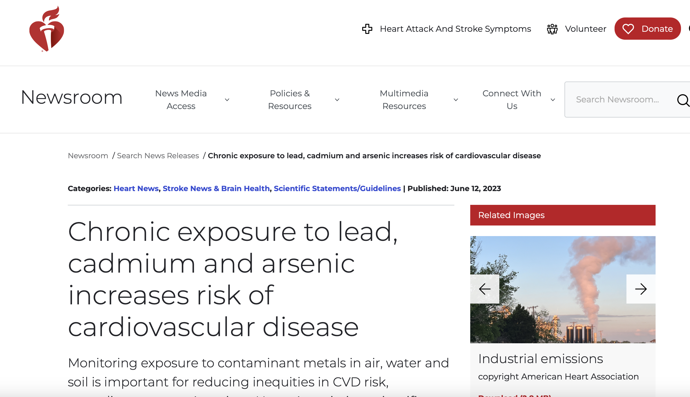

Slide 22
Rachel Silverman Bonnifield
Center for Global Development

Slide 23
Can Lead Poisoning Explain Low Test Scores in Poor Countries?
14 September 2023
Rachel Silverman Bonnifield, Senior Fellow, Center for Global Development
Authors: Lee Crawfurd, Rory Todd, Susannah Hares, Justin Sandefur

Slide 24
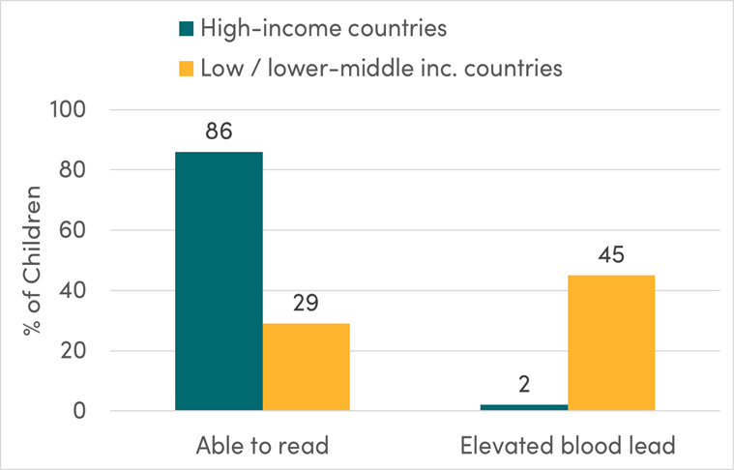
Stylized Fact: Reading proficiency is low in developing countries, and lead exposure is high
Extensive literature links childhood lead exposure to cognitive and learning deficits
Is lead exposure a substantial driver of observed lower education attainment in LMICs?
If so, to what extent can it explain observed learning gaps?
Note: The share of children able to read is the World Bank estimate for minimum reading proficiency at the end of primary school. The share of children lead poisoned is calculated from the numerator in the IHME/UNICEF “Toxic Truth” report and the denominator in UN population estimates.

Slide 25
Our Approach
Systematic review and meta-analysis of observational studies on the relationship between lead exposure and learning outcomes
Adjustments for likely magnitude of unobserved confounding and publication bias
Simulation: What is predicted learning gain if blood lead levels (BLLs) in low- and middle-income countries (LMICs) are reduced to US levels?
Notes:
(Note: 18 estimates had a log-linear specification, 27 had a linear specification, and 18 had a discrete specification.

Slide 26
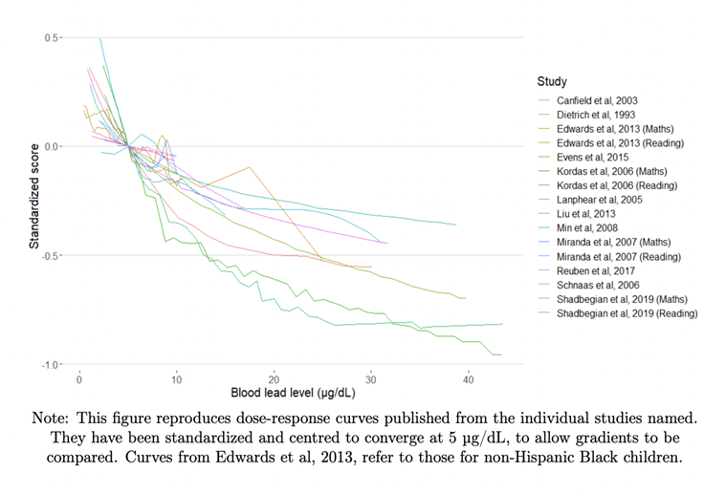
Findings: Relationship Between Lead Exposure and Learning Outcomes
Naïve (uncorrected) meta-analytic result: A doubling of blood lead levels (1 natural log point increase) is associated with a 0.22 standard deviation reduction in learning outcomes.
Corrected for publication bias and estimated magnitude of unobserved confounding: A doubling of blood lead levels (1 natural log point increase) implies a 0.12 standard deviation reduction in learning outcomes.
Notes:
(Note: 18 estimates had a log-linear specification, 27 had a linear specification, and 18 had a discrete specification.

Slide 27
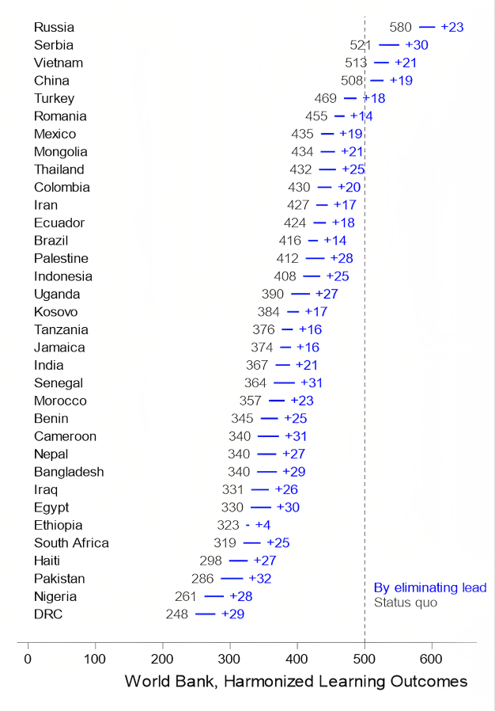
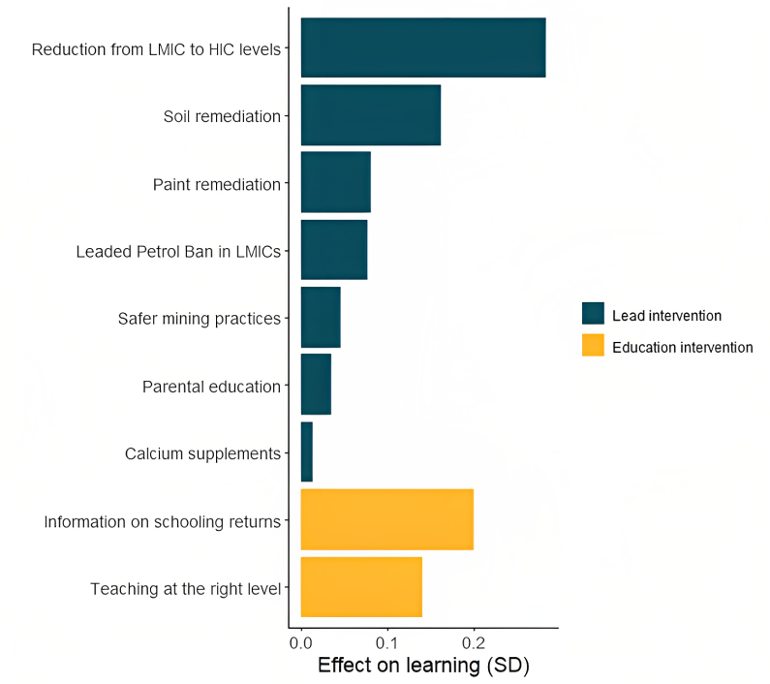
Simulation: Lead Mitigation as an Education Intervention = Potential to fill 21% of learning gap between rich countries and LMICS
Note: Where we have more than one study for an intervention category, this figure shows the median of effect sizes for those studies.
Note: This figure shows the simulated effect on Harmonized Learning Outcomes for each country of reducing average blood lead levels to US levels (0.5 mcg/dl).
Notes:
(Note: 18 estimates had a log-linear specification, 27 had a linear specification, and 18 had a discrete specification.

Slide 28
Emily Nash
Pure Earth

Slide 29


Rapid Market Screening
Lead in Consumer Goods
across 25 Countries
Emily Nash, MPH September 14, 2023
Research Director
Pure Earth

Slide 30
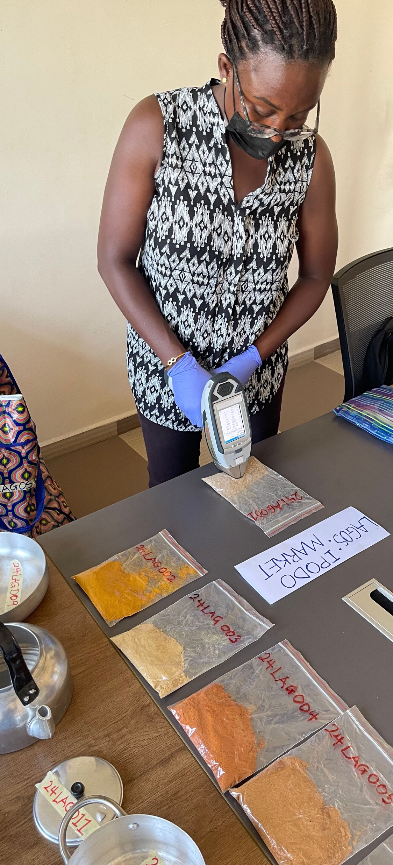
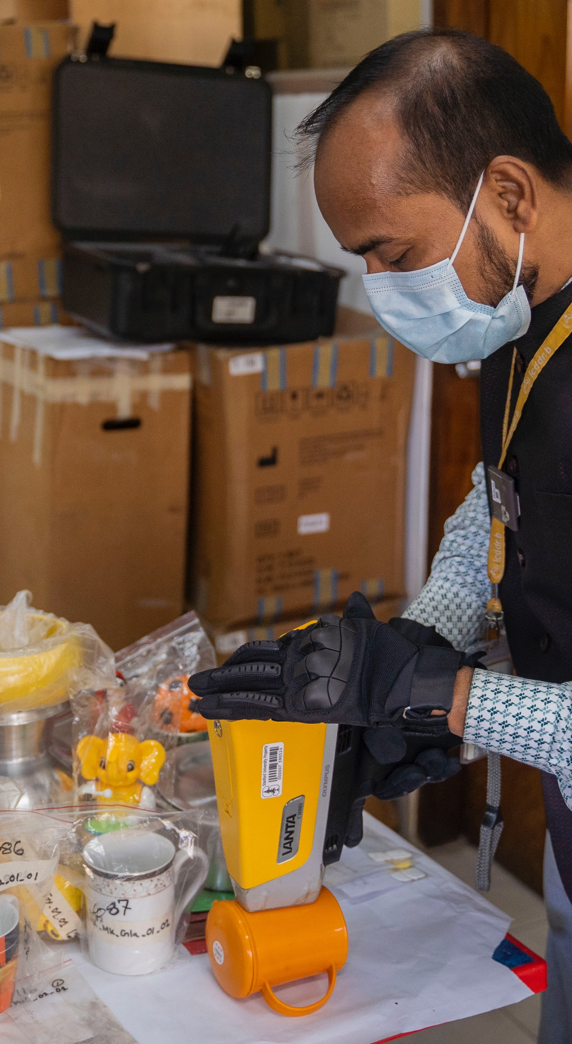

Approach
25 countries (including 3 states in India)
More than 5,000 items
3-4 major cities per country
Wholesale and retail markets
Analyzed with portable XRF
Subset of items sent to US for lab comparison
Product categories
Reference levels
Notes:
Foodware – metallic, ceramic and plastic
Toys
Paint
Spices
Staple dry food
Sweets
Cosmetics
Traditional medicines

Slide 31
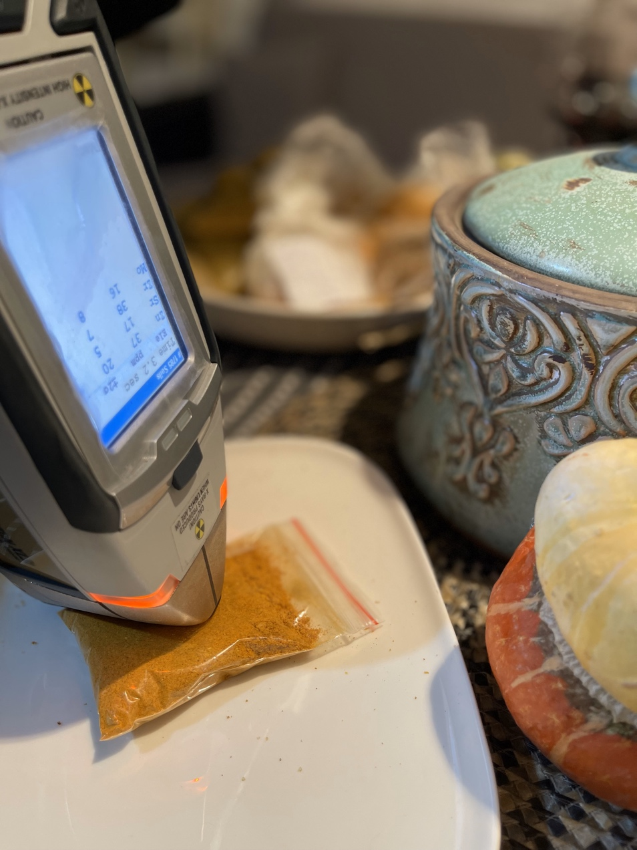
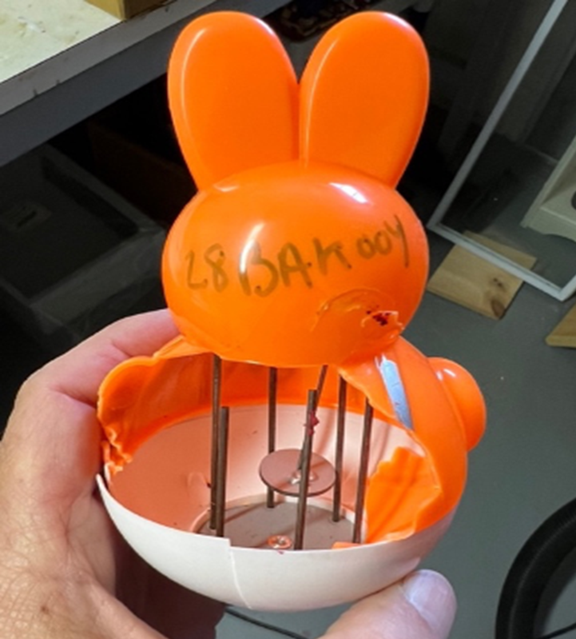
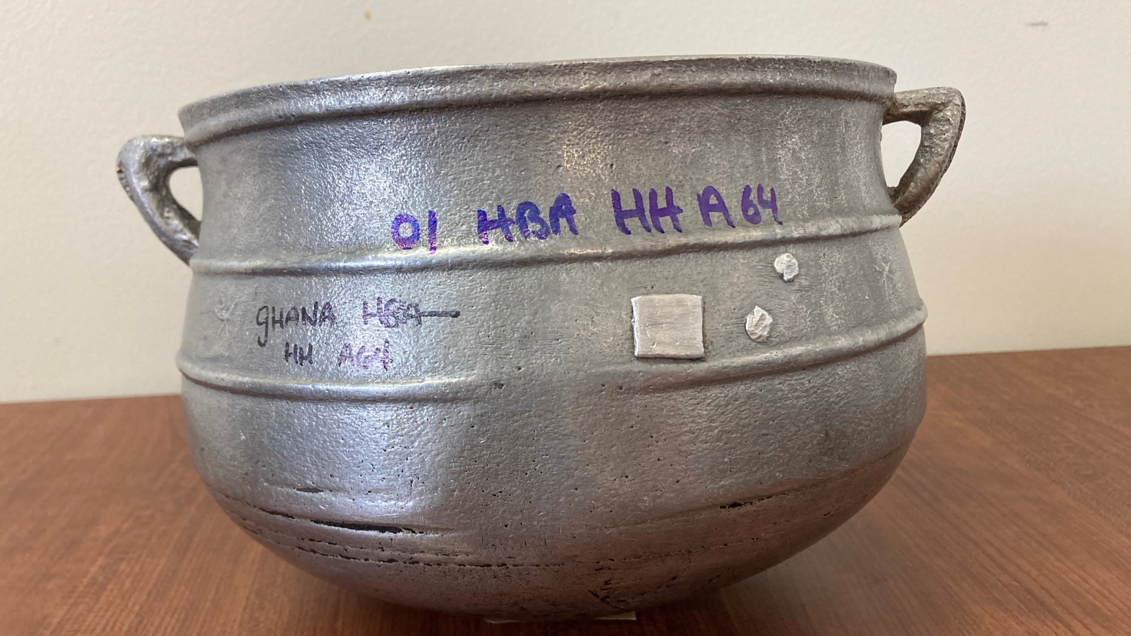
Limitations
  Scope
  Sample size
  Geographic limitations
  Only included specific food items
  Methodology
  XRF measures “total lead concentration”
  XRF limit of detection
  Heterogeneity of products
Notes:
Biggest survey that we are aware of
But at country-category level limited sample size
Suggestive not conclusive
– does not necessarily reflect amount of lead that would leach or enter the body
– used highest XRF reading

Slide 32
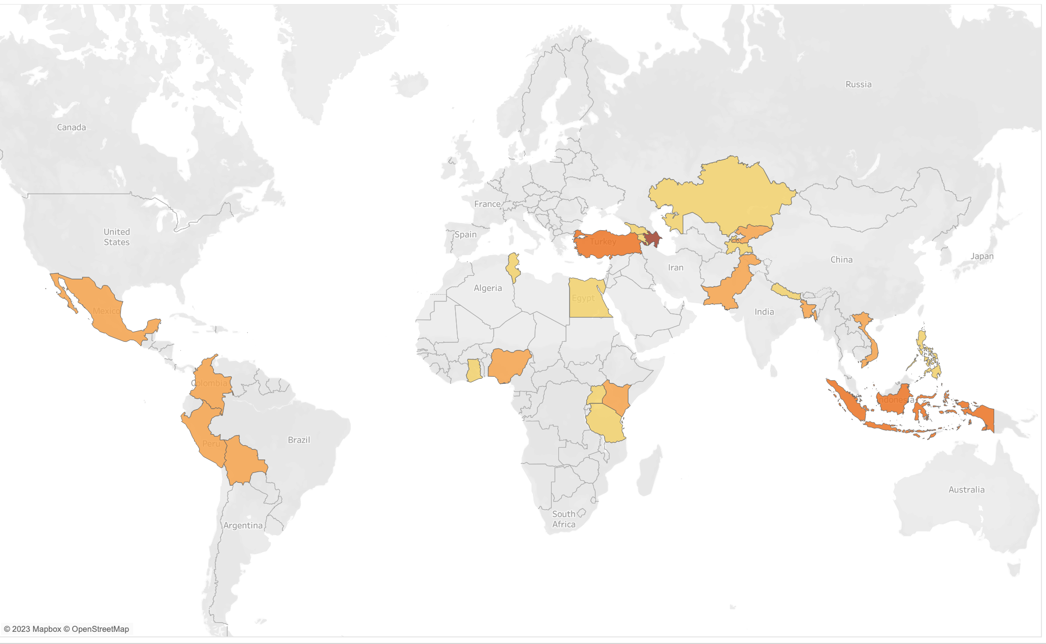
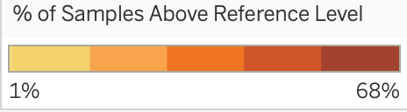
High-level findings by country
Notes:
Geographic spread among LMICs
Latin America, MENA, East Africa, West Africa, Caucuses, Central Asia, South Asia, Southeast Asia
The color coding here indicates (less than 10 to 68%)

Slide 33
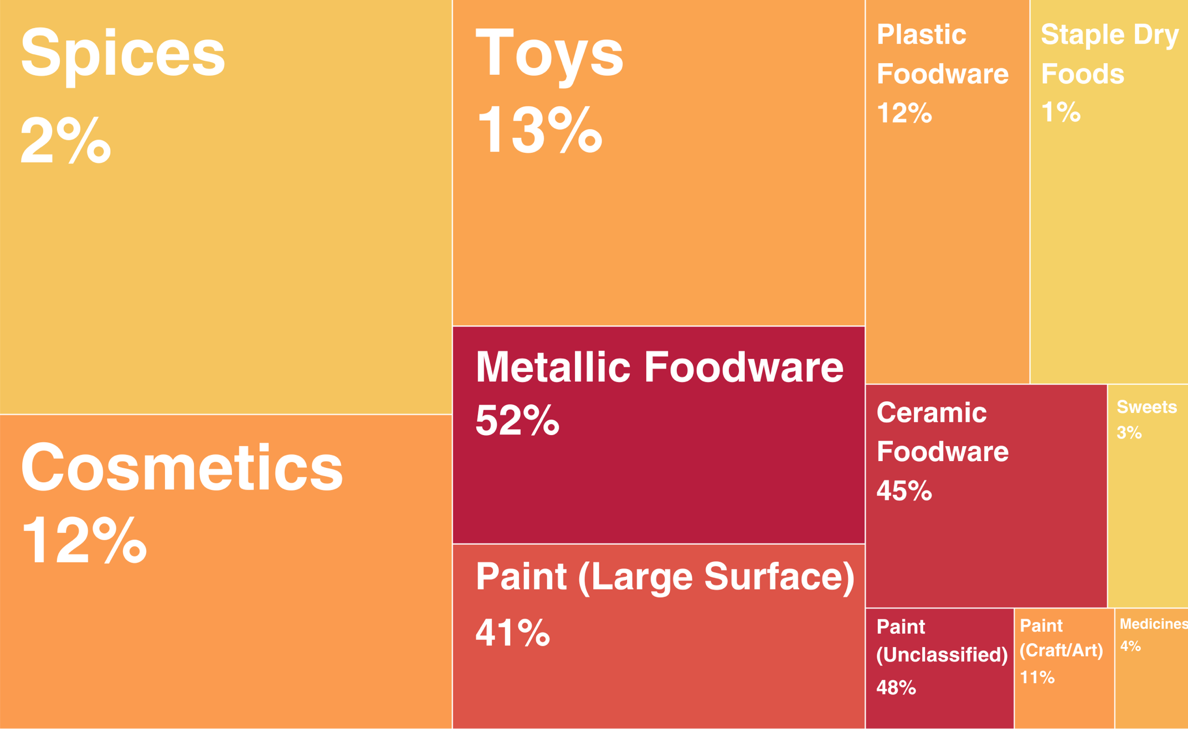
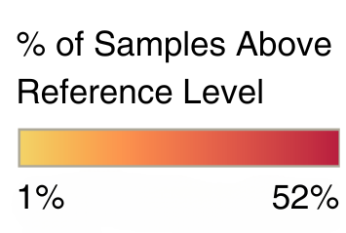

High-level findings by product type
Across all 5,010 samples: 18%
Metallic foodware: 52% of 518 samples
Ceramic foodware: 45% of 310 samples
Paints (large surfaces): 41% of 437 samples
Toys: 13% of 781 samples
Plastic foodware: 12% of 364 samples
Cosmetics: 12% of 815 samples
Paints (art, crafts, & special uses): 11% of 70 samples
Traditional and herbal medicines: 4% of 54 samples
Spices: 2% of 1085 samples
Sweets: 3% of 111 samples
Staple dry foods: 1% of 362 samples
Box size is proportional to the number of samples in each product category

Slide 34
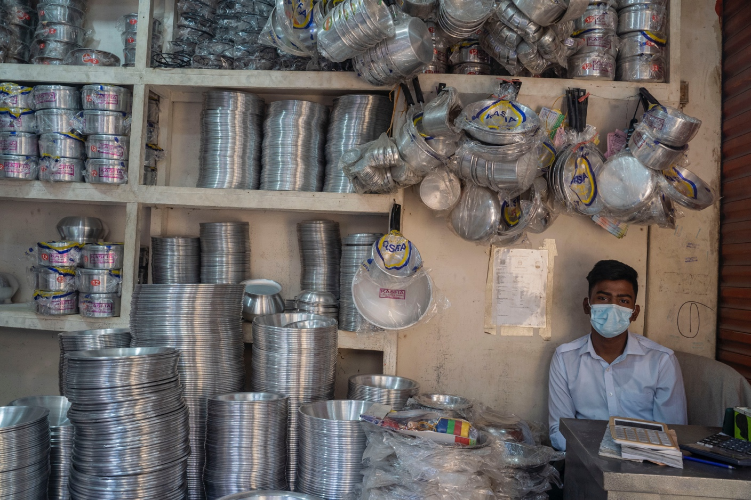
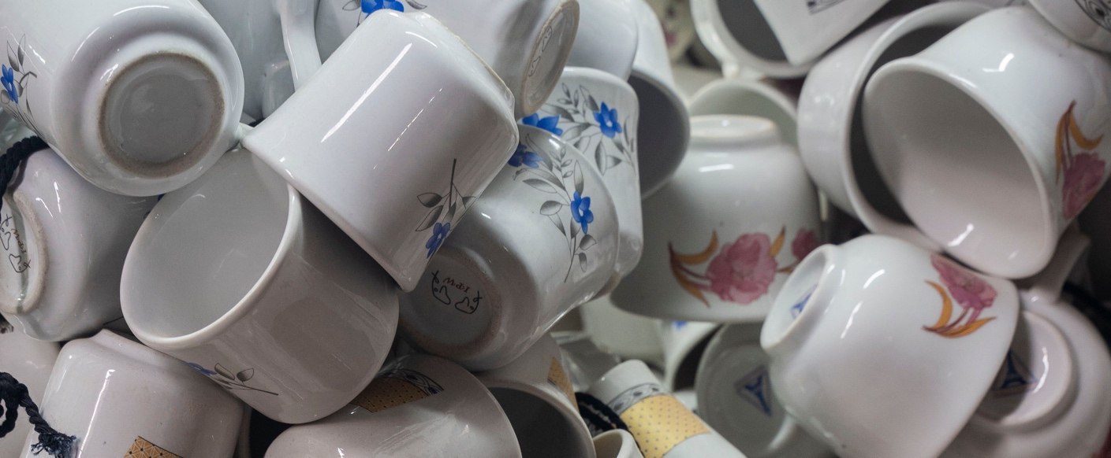
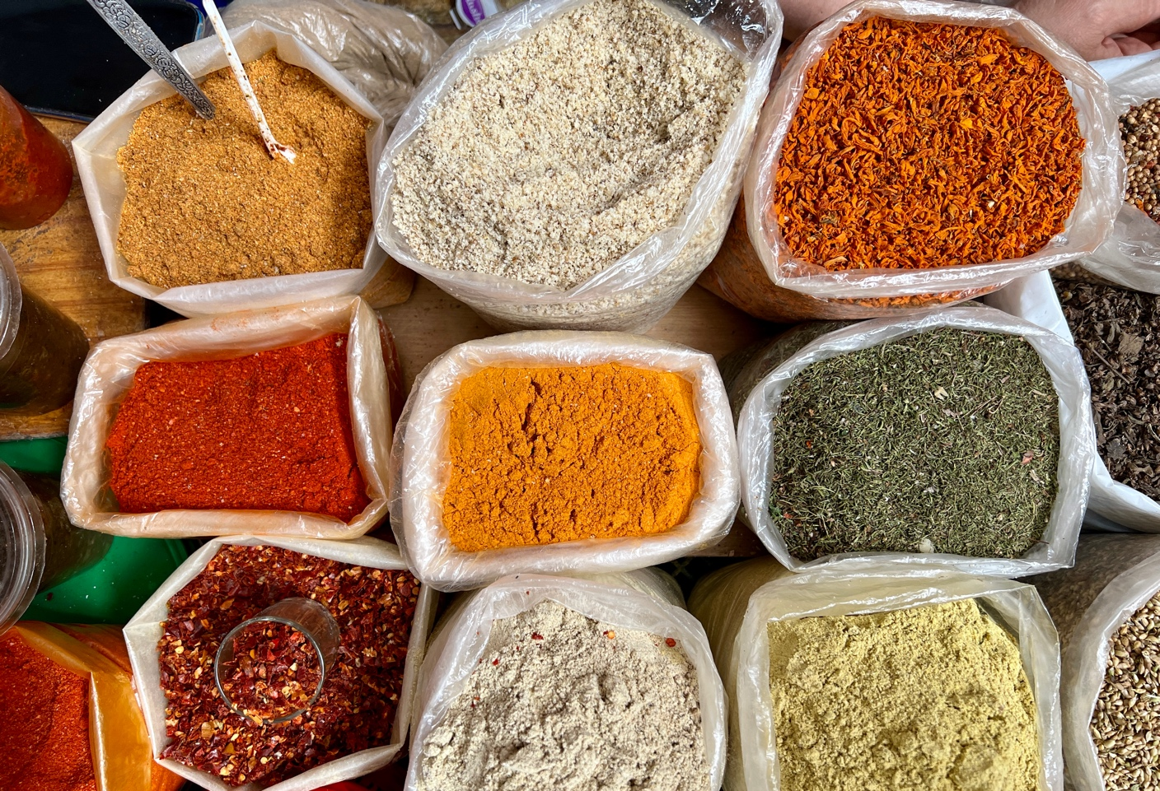
Detailed findings for select categories
Metallic Cookware
  Common across all regions
  Above reference level, potential for Pb in leachate at concentrations above WHO drinking water standard
Ceramic Foodware
  Common across all regions
  Pb in exterior glaze and decorative paints
Paints
  High Pb concentrations prevalent even among countries that have already adopted 90ppm limit
Cosmetics
  Elevated Pb concentrations across many subcategories
  Highest concentrations in traditional eyeliner
Spices
  Highest concentrations found in turmeric and blends
  Regional trends
Notes:
Metallic
in 17 locations, median exceeded the reference level; in 9 locations, max exceeded 10,000 ppm
Conducted leachate testing on more than 90 pots from 23 countries and 5 regions
Above 100 ppm – potential for leachate above 10ppb – 0.5 ug/dL (IEUBK)
Ceramics
In 11 countries, median above reference; 25 study location max more than 10times ref
Well-documented in Mexico and have been identified in other regions, but PE surprised by extent; mass produced
Type of glaze, how it is fired, and how the item is used all can influence leachability – more research

Slide 35

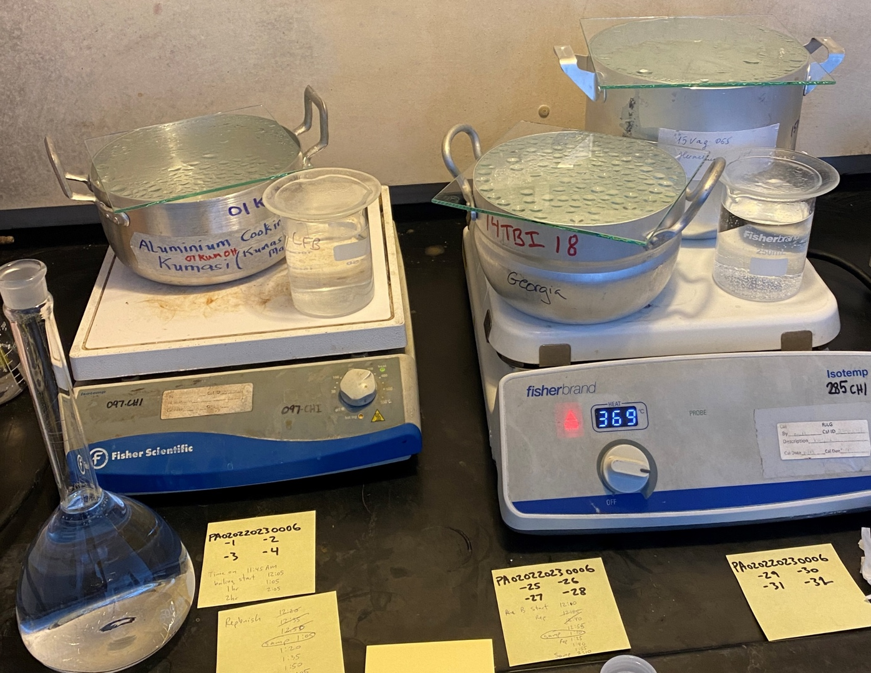
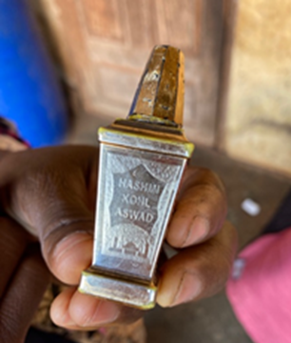

Key Recommendations
Additional research on leachability – particularly in metal and ceramic cookware
Enact and enforce lead paint laws
Supply chain analysis for cosmetics
Replicate programs to eradicate spice adulteration
Blood lead level testing
Home-based source assessments

Slide 36

Photo Credit: Pure Earth
Thank You

Slide 37
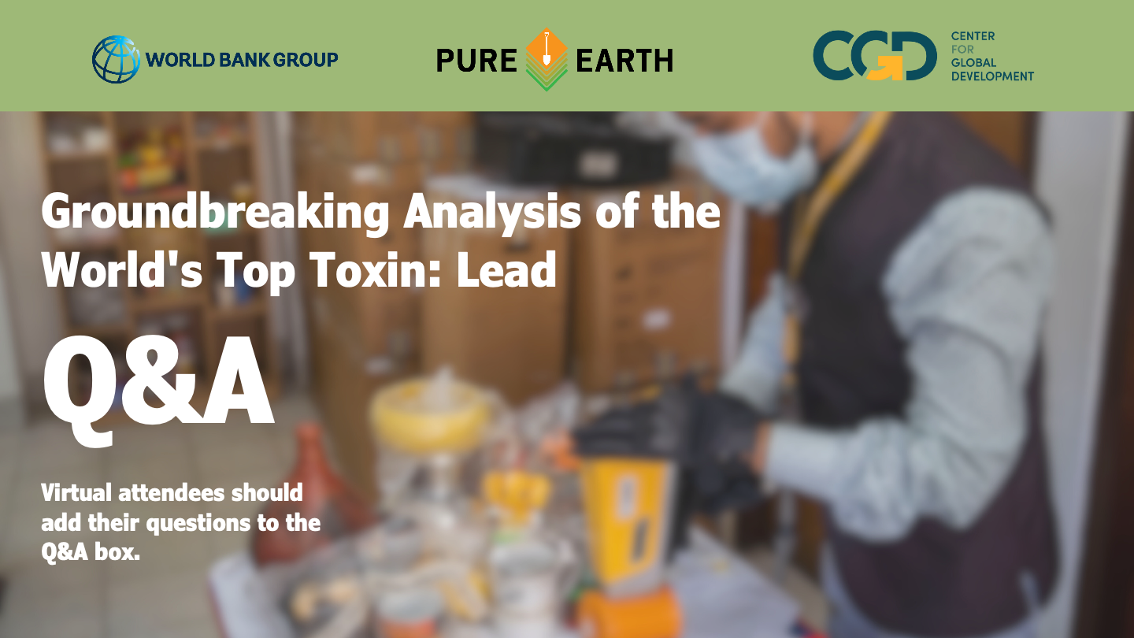

Slide 39
Richard Fuller
Pure Earth

Slide 40




Interventions: Cost Effectiveness
World Bank benefit/cost analysis of interventions – pending publication
Limited number of projects to analyze, so results are suggestive
Cost benefit per DALY for some interventions is less than $1
Contaminated Site Cleanup
(17 projects):
$2-$144 benefit
per $1 invested
Moving to Lead-Free Pottery
(1 project):
$326 benefit
per $1 invested
Regulating Lead-Based Paint
(1 project):
$1200 benefit
per $1 invested
Eliminating Lead in Spices (2 projects): Up to $20,500 per $1 invested

Slide 41
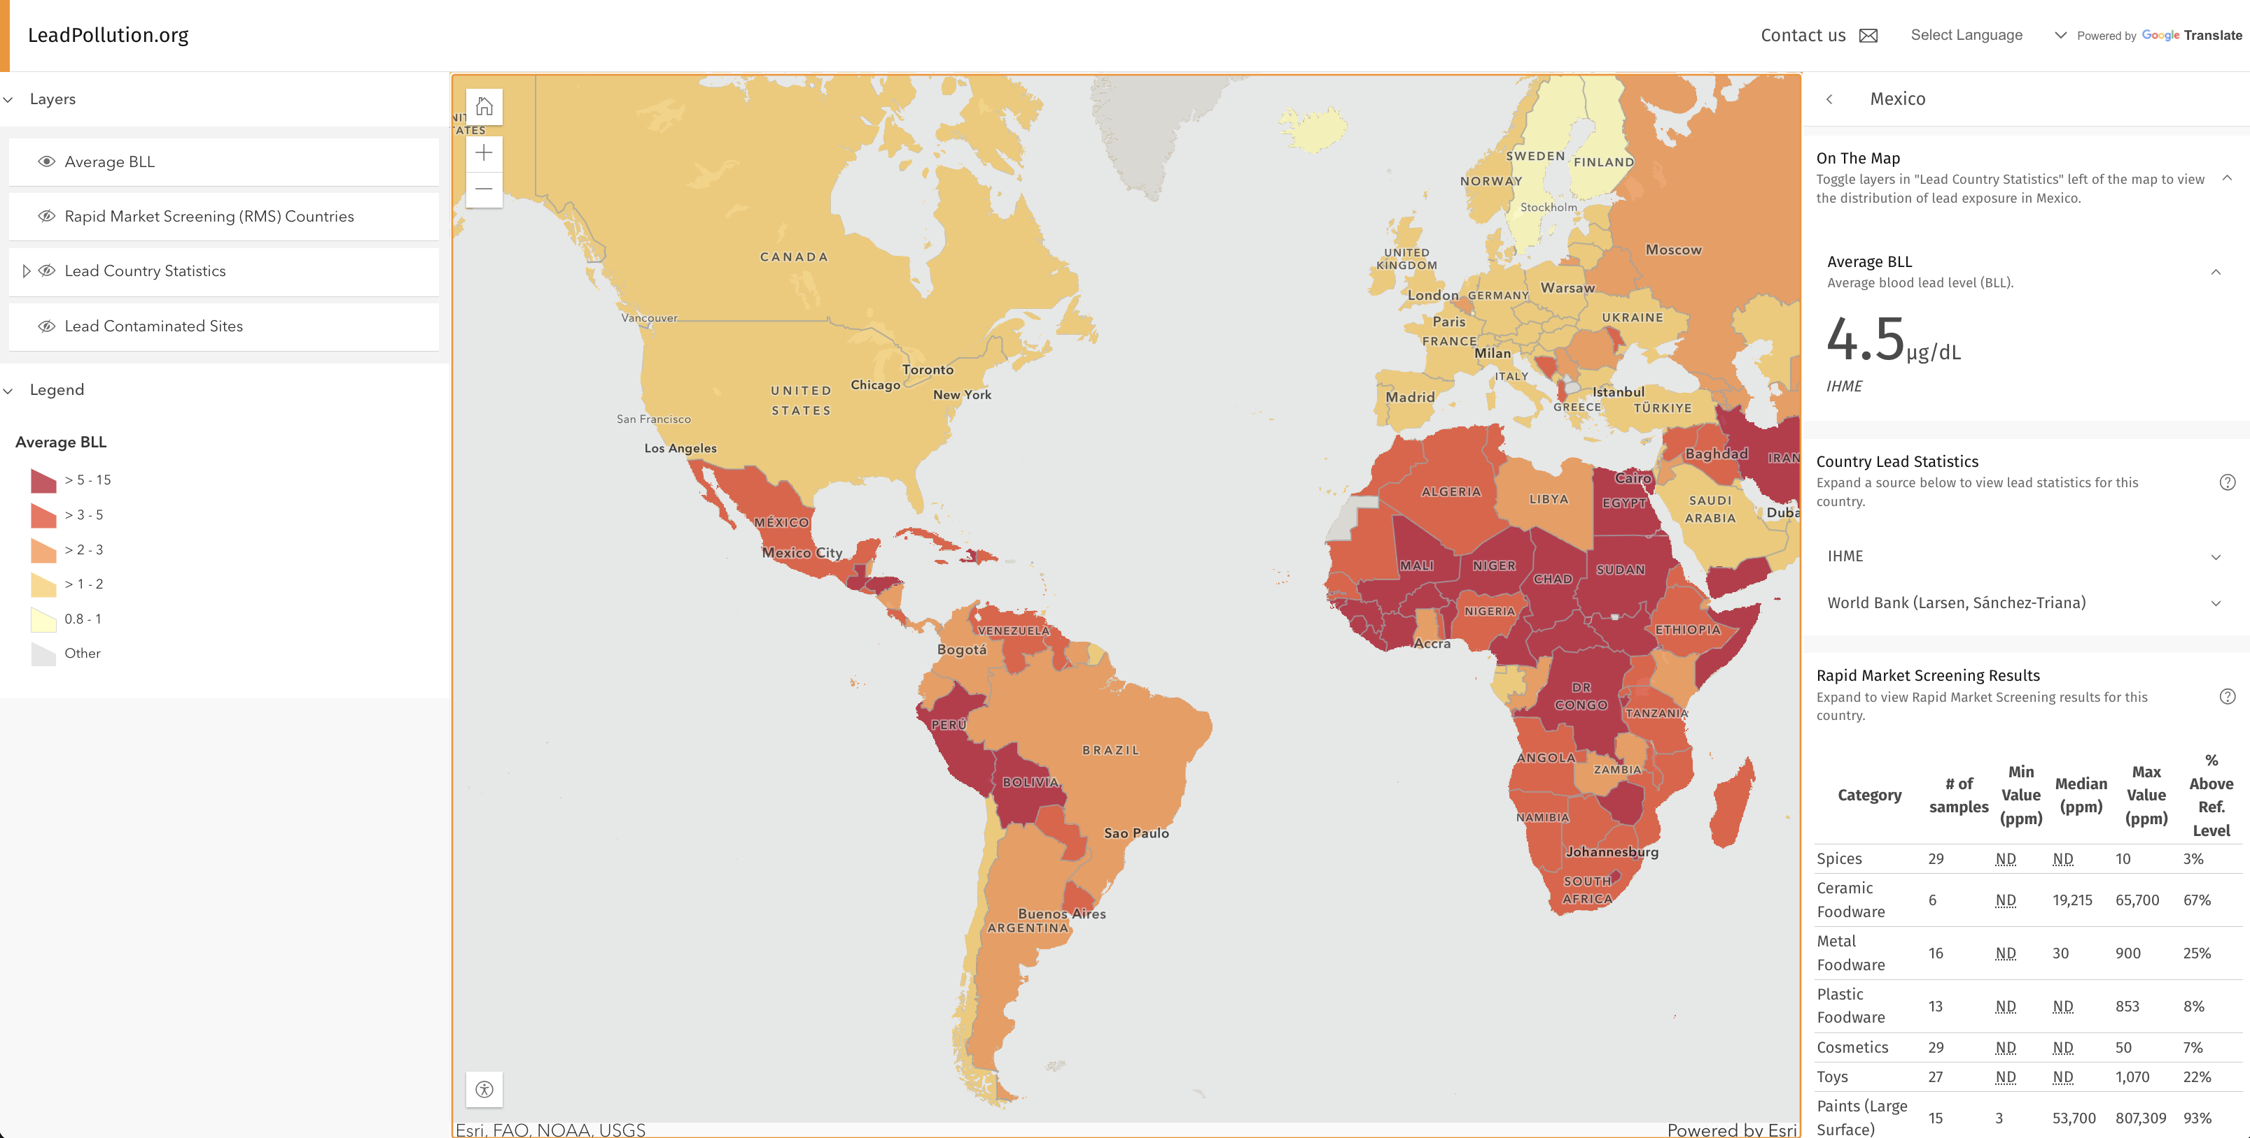

Slide 42
Dan Kass
Vital Strategies

Slide 43
Blood-Lead Surveillance Strategies in the Absence of Universal Testing:
Closing a Critical Evidence Gap to Drive Solutions
Dan Kass, Vital Strategies
Country | Features | Strengths | Weaknesses
Peru | Nationally-representative active surveillance Clinic-based, with comprehensive neuro-developmental assessment Government-led Field instrumentation for capillary blood Paired with environmental sampling | Strengthens health system response Low-cost, in-kind contributions High participation rate Risk factor identification Data-to-policy pathway Basis for future risk-assessment surveillance system | Time to initiate Limitations of instrumentation Subject to crisis-driven delays
Bihar, India | State-representative active surveillance Household-based NGO/Research institution-led Field instrumentation for capillary blood Paired with environmental sampling | Rapid implementation Evidence to drive future gov’t engagement Rapid sharing of results to participants Low-cost | Lack of direct gov’t engagement Limitations of instrumentation Capacity not built in health system Reproducibility
Philippines, Georgia | BLL paired with National Nutritional Survey/ National Multiple Indicator Cluster Survey Lab-based venous blood analysis | Reproducibility and sustainability Highly accurate results Low supplemental cost Government engagement and reporting platform Rapid response to findings | Limited evaluation of risk factors; self-reported No paired environmental samples Venous draws may limit participation, delay notification
Why?
Exposure risks vary widely by geography, demographic and social factors
Modeled data is inadequate and often met with skepticism
Hot-spot analysis insufficient to characterize a population
Need to direct resources where impact would be greatest
Enable future low-cost risk assessment in the face of limited testing capacity
Capacity-building and awareness raising
Timely response to elevated BLLs
Strengthen public and policymaker advocacy

Slide 44
Angela Bandemehr
US EPA

Slide 45

EPA’s Efforts on Capacity Building to Reduce Lead Exposure in LMICs
Key EPA Activity:
G7
EPA works to build capacity in LMICs, building on lessons learned from US domestic efforts to reduce lead exposure
Contributed to successful global phase out of lead in gasoline
Working to eliminate lead paint through the Global Alliance to Eliminate Lead Paint
G7 discussions on potential further collaboration
EPA participation in this event should not be construed as endorsement of views expressed by others.

Slide 46
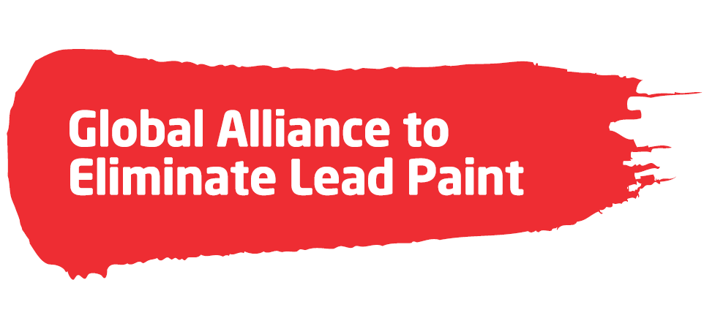
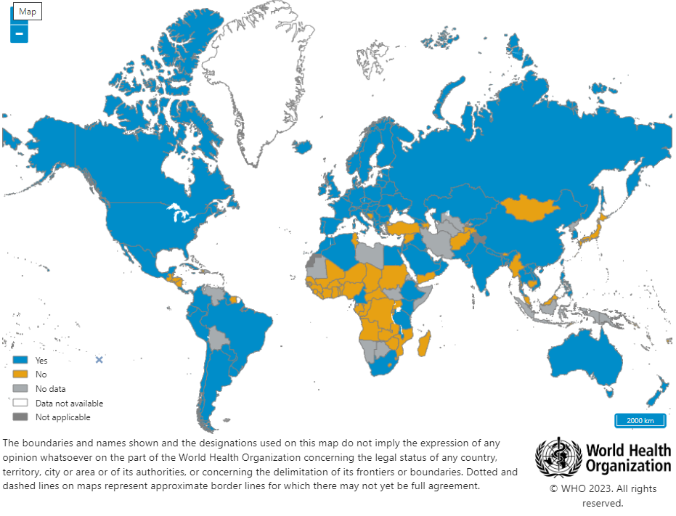
Lead in Paint
Global Alliance to Eliminate Lead Paint:
Assisted at least 20 countries in enacting laws
Additional several dozen countries in the process of establishing laws
Paint producers are working on reformulation
48% of countries have lead paint laws
Factors contributing to success:
Build on track record of countries whose regulations lead to reformulation of paint and lowered lead levels
Ability to promote active government and industry engagement
Provide credible guidance and drafting assistance from the Alliance
Global reach through partnership with WHO and UNEP
https://www.who.int/data/gho/data/themes/topics/indicator-groups/legally-binding-controls-on-lead-paint
EPA participation in this event should not be construed as endorsement of views expressed by others.

Slide 47
Abheet Solomon
UNICEF

Slide 48

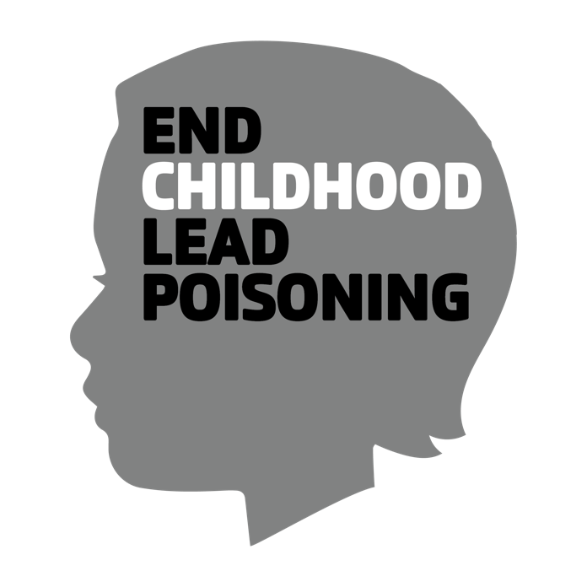
Actions to
End Childhood Lead Poisoning by 2040
Abheet Solomon, UNICEF
Governments take leadership and prioritize action
#1. Assess childhood lead exposure and its sources
#2. Act decisively across sectors
#3. Develop capacities to protect children
#4. Toughen measures to reduce lead in the environment
#5. Eliminate the sources of lead poisoning
#1. Stop the use of lead in consumer products
#2. Ensure safe stewardship of lead in industrial applications
#3. Account for supply chains
#4. Comply fully with laws and regulations
#5. Share information and expertise
Private Sector ensures responsible use of lead and safe stewardship
Civil Society inspires others to action
#1. Advocate for decisive action from governments and industries
#2. Mobilize communities to demand better protection
#3. Educate networks on the issue
#4. Research the sources and effects of lead
#5. Support the national response

Slide 49
Governments take leadership and prioritize action
The Government fully recognizes that childhood lead poisoning is an issue of serious concern in the country that must be addressed
The Government has data on the levels of childhood lead exposure as the basis for action
The Government has a potential list of sources of childhood lead exposure in the country as the basis for action
Institutional mandates to address the issue of lead poisoning across health and environment sectors are in place
Coordination mechanisms involving education, trade and industry, labour and other relevant sectors are in place
Strategy or plan to address lead poisoning is in place and this is reflected across the priorities of key sectors
The health system is equipped to prevent and manage lead poisoning
Risk communication measures to increase awareness and protecting children are being implemented
Surveillance system to periodically monitor childhood lead poisoning and address the sources is in place
Appropriate laws, standards, and regulations to eliminate or limit the use of lead in all consumer products are in place
National standards/regulations and strategies for the environmentally sound management of lead in industrial applications are established
There is environmental protection capacity to identify and address the sources of lead poisoning
National standards to ensure the elimination or limit the use of lead in all consumer products and the environmentally sound management of lead in industrial applications are being enforced
Policy and economic measures that promote environmentally sound and safe recycling while promoting livelihood opportunities for the informal recyclers of used lead-acid batteries and electronic waste are being implemented
Contaminated soil and water in the environment is being addressed through remediation measures or replacement of infrastructure
#1. Assess childhood lead exposure and its sources
#2. Act decisively across sectors
#3. Develop capacities to protect children
#4. Toughen measures to reduce lead in the environment
#5. Eliminate the sources of lead poisoning

Slide 51


